Slide 1
Hashing & Collision Resolution:
Linear Probing & Division Method
Darren Galvez 5/12/2025

Slide 2
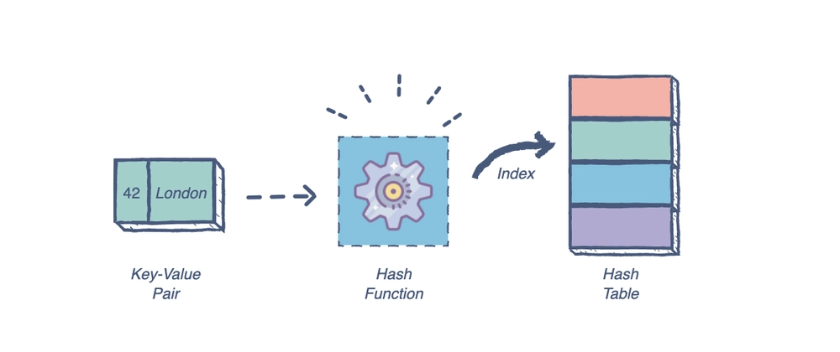
What is Hashing?
Hashing is a technique to map data (keys) to a fixed-size table using a hash function.
It allows for fast data access, insertion, and deletion.
Commonly used in data structures like hash tables and hash maps.

Slide 3
The Division Method
Formula: h(key) = key % tableSIZE
Example of the Formula: key = 35, tableSIZE = 6, h(35) = 5
Pros & Cons of The Division Method:
Pros:
Easy to implement
Memory Efficient
Simple & Fast
Cons:
Limited Table Size
Clustering Issues
Sensitive Key-Patterns

Slide 4
Linear Probing
Method: If collision, check next slot (index + 1) % table size
Probing is to be continued until an empty slot is found
Pros:
Simple to implement
Cache Efficiency
Cons:
Clustering can occur
Less effective with poor hash functions

Slide 5
Hashing Summary
Division Method: Simple and effective with prime table size
Linear Probing: Easy collision resolution

Slide 6

Thank you for Watching!

